Slide 1
Big Mountain Resort
Slide Deck for the Executive Team

Slide 2
Problem Identification
Before the ski season opens this year, what is the optimal ticket price for Big Mountain offer to its customers that creates the best value for its facilities compared to the competition creating an increase in revenue for the resort that, at a minimum, will cover the $1.5M cost of operating the new ski lift by the end of the ski season?
What other strategies exist to either cut costs or support a higher ticket price?

Slide 3
Recommendations and Key Findings
Increase ticket price by $2 before this season.
The resort can leverage existing amenities for a price hike.
The model suggests between $4.48 and $14.87 price increase would be in-line with the current amenities offered at the resort.
A 5-day pass purchased by each guest this season would offset the increased cost of the new lift by more than double.
Begin planning to implement scenario 2 for future revenue enhancement.
Scenario 2 provides an opportunity to further accentuate BMR’s revenue streams.
The model suggests that BMR can justify an additional $1.99 on the ticket price once the changes are implemented.
A 5-day pass purchased by each guest over the course of that season could potentially accrue an additional $3.47 million in revenue.
Gather more data and explore scenario 1 further.
Scenario 1 show promises and should be analyzed further.
The model indicates BMR could close as many as 5 of the least used runs with a minimal impact to ticket price.

Slide 4
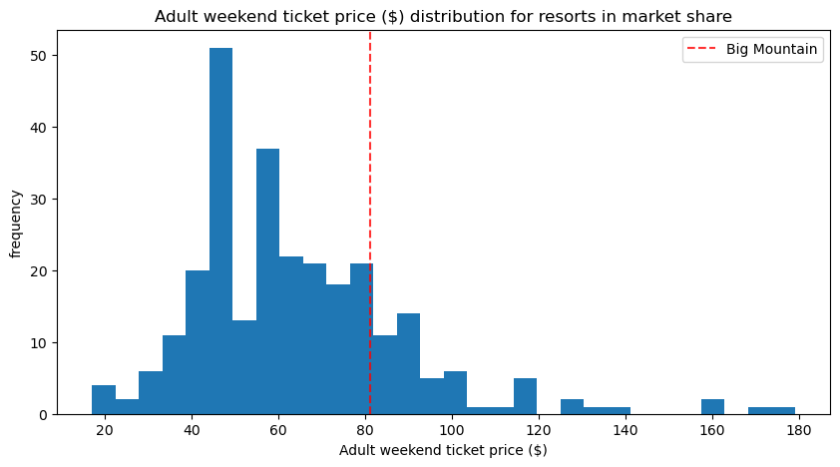
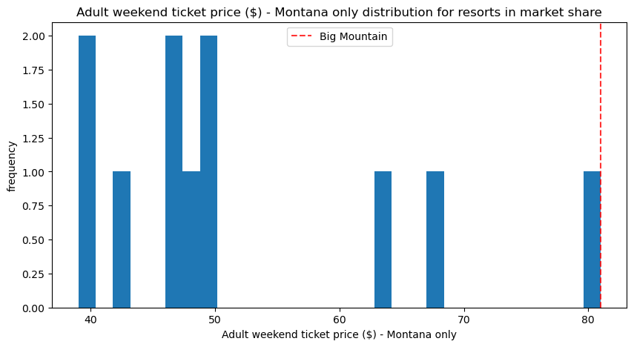
Ticket Price Analysis Recommendation 1: raise ticket prices by $2 for this season
While BMR’s ticket price is on the high-end both in Montana and nationally, the model suggests that ticket price could be increased.
With a current price of $81, the model projected a ticket price of $95.87, with a standard error of $10.39. This variance underscores a promising window of opportunity for a price escalation without adding new features, particularly given BMR's possession of several premium amenities that are in high demand in the ski resort market.

Slide 5
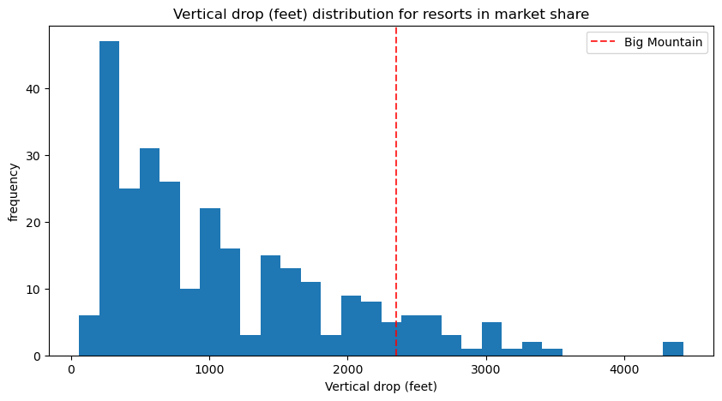
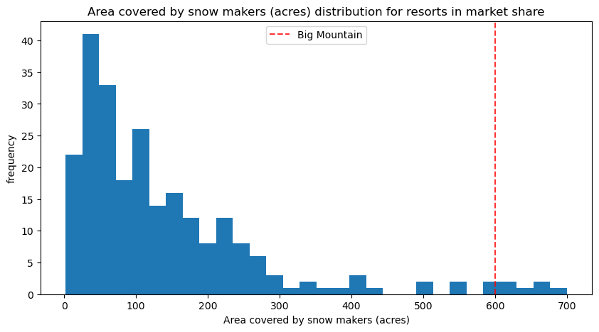
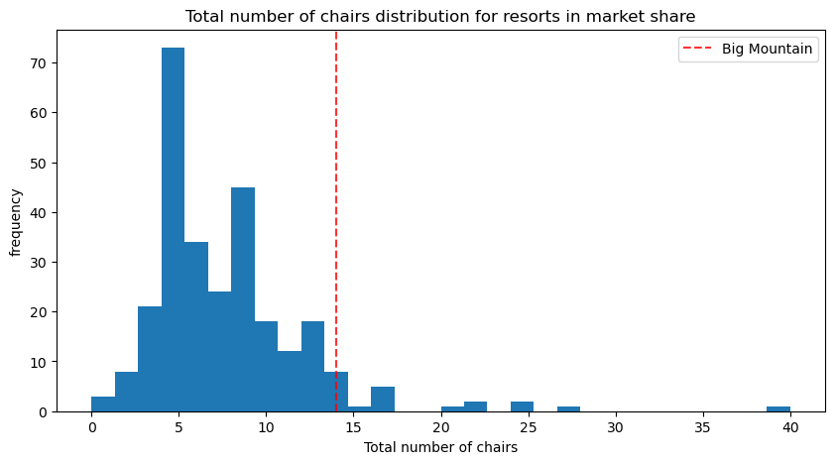
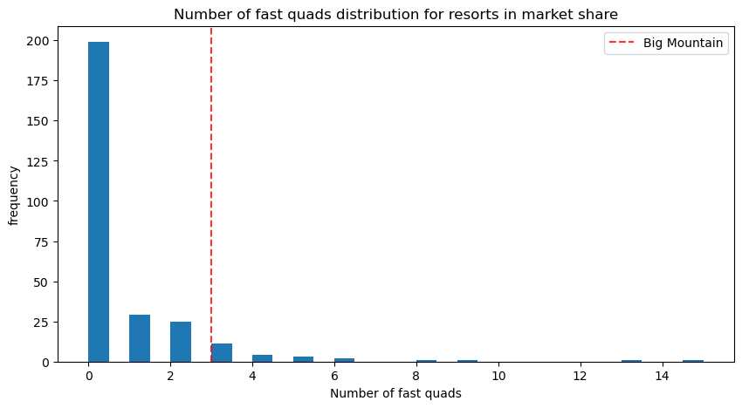
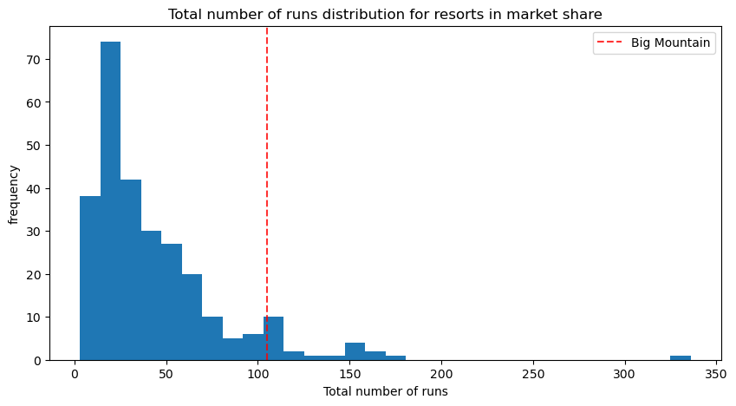
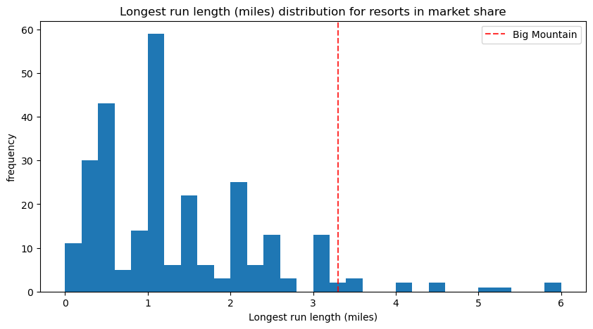
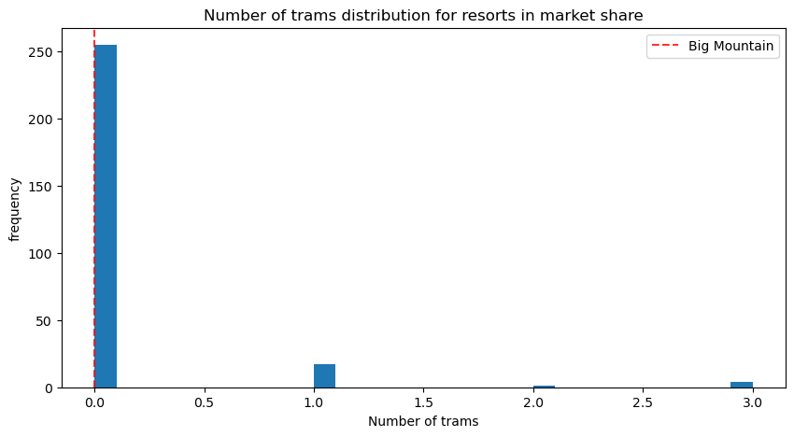
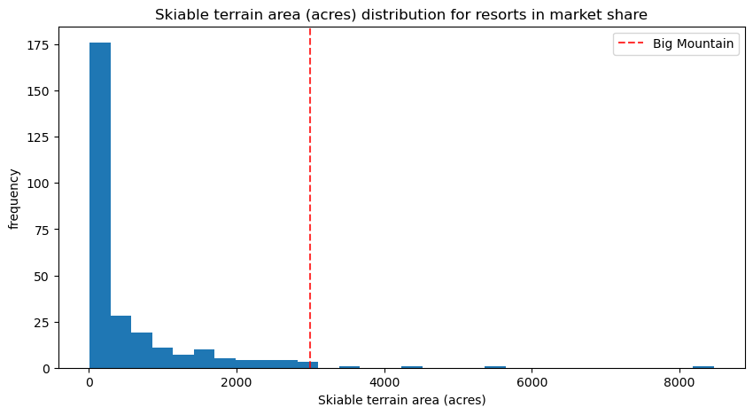
Features that Drive the Highest Price Below is shown BMR’s standing within the features that drive price

Slide 6
The Importance of BMR’s Features And how they will drive the ticket price now and in the future Recommendation 2: begin to plan to implement scenario 2
As you can see, BMR is at the top of the league table when it comes to the resort features that drive the highest ticket prices.
The fact that Big Mountain Resorts possesses many of these amenities could justify the modeled price increase without adding any new features (recommendation 1) as they are not needed to drive price.
But these features and amenities also play a key role in recommendation 2: implementation of scenario 2.
Scenario 2 adds all in-demand features. By adding a run, enhancing the vertical drop by 150 feet, and incorporating a new chair lift, BMR can justify an additional increment of $1.99 in the ticket price. This adjustment, extrapolated over the course of the entire season (5-day pass), could potentially accrue an additional revenue of approximately $3.47 million.

Slide 7
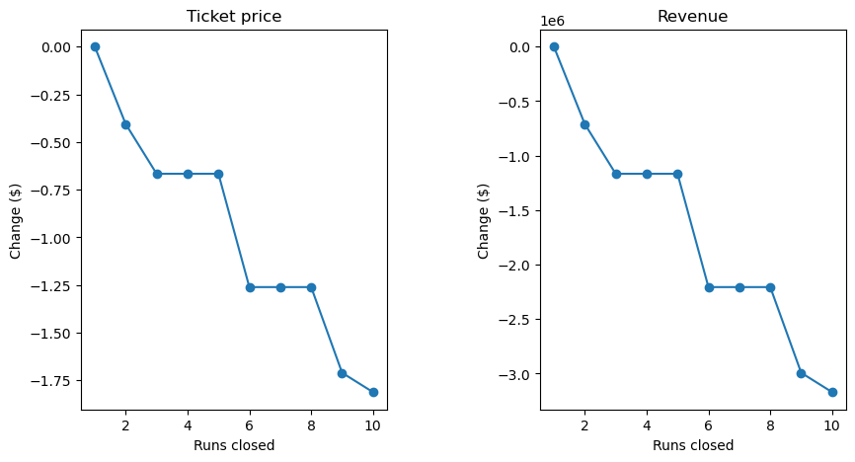
Modeling Results & Analysis of Run Closures Recommendation 3: scenario 1, very promising, but further analysis is needed.
The model indicates that BMR could close up to 5 runs without a significant hit to ticket price.
To understand how this could be a cost saving measure, an analysis of the costs must be added into the revenue model on the right.

Slide 8
Summary & Conclusion
As we forge ahead, our primary goal remains to maximize BMR's potential while offering unparalleled experiences to our visitors. Our 3-step recommendations aims to do just that.
By adopting a more data-centric approach, we are not only poised to enhance profitability but also fine-tune our investment strategies for the future. We believe these recommendations mark the beginning of a transformative journey for Big Mountain Resort, steering it towards a future marked by innovation and financial robustness.

